Slide 1
Lecture 12: BA Program in Practice
Prof. Mike Boyle
Department of Operations and Information Systems
University of Utah

Slide 2
Overview
Organization/ Strategy Assessment
BA Organization Assessment
BA Hiring/ Reallocation
BA Project Prioritization, Execution and Assessment

Slide 3
Organization/Strategy Assessment
Strategic position of organization
Strategic KPIs
Functional KPIs
Analysis: Organization as a set of value-adding processes supported by BA

Slide 4
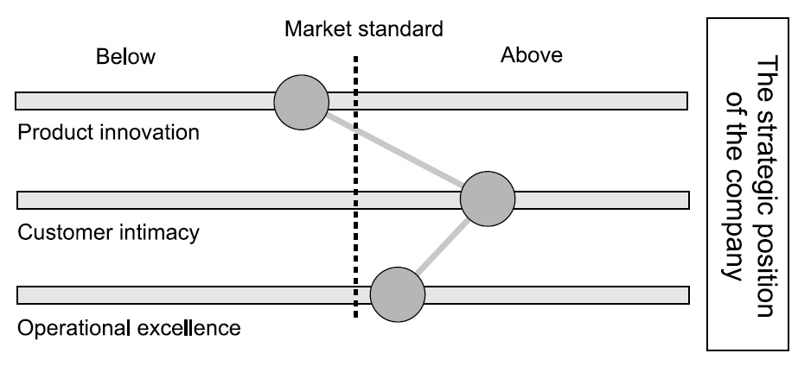
Strategic position of organization
Source: Laursen, G. and Thorlund, J., “Business Analytics for Managers” Wiley, 2010

Slide 5
Information Strategy Framework
Who | What to do | Details
Senior Management | Set strategic targets for biz | <Strategic KPI 1> <Strategic KPI 2>
Operations | Set strategic target at functional level Improve on business processes at functional level Use information to make tactical decisions | <Operational KPI 1>; related to <Strategic KPI 2> <Operational KPI 2>; related to <Strategic KPI 1> and <Strategic KPI 2>
Business Analytics function | Gather requirements and create analytical assets | <BA Project 1> <BA Project 2>
Data Warehouse function | Provide data for analytical assets | <BA System Feature 1> <BA System Feature 2>
Data source and IT infrastructure function | Develop and maintain transactional and other business systems | <Data Source 1> <Data Source 2>
Source: Laursen, G. and Thorlund, J., “Business Analytics for Managers” Wiley, 2010

Slide 6
The organization as value-adding processes
Organization viewed as a set of primary/secondary/BA processes and competencies
Primary Process 1
Competencies
Secondary Process 1
Secondary Process n
BA Process n
BA Process 1
Note: not all primary and secondary processes are supported by BA

Slide 7
The organization as value-adding processes (cont’d)
Manufacturing Organization viewed as a set of primary/secondary/BA processes and competencies)
BA programs can have relatively high levels of success when viewed as this abstraction
Why is this abstraction important?
Reduces complexity in analysis and communication
What are some challenges of this view of the organization?
Organizations typically have departments but processes often span departments
E.g. 1) acquire raw materials; 2) manufacture products; 3) warehouse products; 4) sell products;
Manufacturing, Warehouse Mgmt, Marketing, IT, Analysis, HR, etc.
Maintain machinery
Training
Customer satisfaction analysis
Machine performance reporting

Slide 8
BA Organization Assessment
BA Maturity Level
Current Gaps/Misallocations Related to Maintaining Maturity Level
Current Opportunities to Improve Maturity Level

Slide 9
BA Maturity Framework
Maturity Level | Focus areas and characteristics | Characteristics of Information System | Processes | Competencies
4 | Focus on optimizing Information System Better and cheaper information and knowledge Pervasive BA | Automated systems push Lead and Lag Information to users | Lead and Lag Information accessible to both Sr. Mgmt and Operational processes | Competencies that optimize processes based on strategic business and analytical insight
3 | Focus on generating Lead Information Large amounts of information; medium amounts of knowledge; some automation | Analytical competencies support a systemized generation of Lead Information On-demand distribution of Lag Information | Sr. Mgmt processes are supported by Lead Information Operational processes are supported by Lag Information | Analytical competencies with sound business insight
2 | Focus on generating Lag Information Medium amounts of information; small amounts of knowledge | Data combined in a data warehouse Reporting systems established | Key people have access to Lag Information Analysts spend most of their time generating reports and lists | Data warehouse competencies with basic analytical knowledge
1 | No focus on BI Large amounts of data; small amounts of information | Built on source data and fragmented data islands | Very few “power users” Difficult to access information Few analytical competencies | Varying IT competencies
Source: Laursen, G. and Thorlund, J., “Business Analytics for Managers” Wiley, 2010

Slide 10
Gaps/misallocations related to maintaining current BA Maturity level
Title | Is Gap or Misallocation? | Description | Impact (1 – 5) | Mitigation Approach(es) | Additional Comments

Slide 11
Opportunities to improve current BA Maturity level
Title | Primary Maturity Level Target Area | Description | Impact (1 – 5) | Approach | Additional Comments

Slide 12
BA Hiring/Reallocation
Information Management
Analysis
Culture/Leadership

Slide 13
Analysis: Analyst Competency Assessment Framework
Area | Description | Score teachables (1 – 5) | Score unteachables (1 – 5)
Business and domain knowledge | E.g. understand eCommerce (business) and Marketing (domain) role therein; understand objectives, strategy and competitive landscape of the biz;
Analytics competency expertise | Intelligent; detail-oriented; curious; open-minded; objective; ethical; systematic in analytical approach; expert in analytics tools; creative with sources and uses of data
People skills | Self-aware; sociable and likeable; empathetic; visible day to day; active listener; design and ask calculated questions; respectful of peoples’ time; proactively build trust with stakeholders
Presentation and influence skills | Transform details into simple concepts; information visualization; audience-aware, business-aligned presentation material; understand cognitive biases and present accordingly; influence action through effective communication and follow-up

Slide 14
Information Management: BI Engineer Competency Assessment Framework
Area | Description | Score teachables (1 – 5) | Score unteachables (1 – 5)
Business and domain knowledge | E.g. understand eCommerce (business) and Marketing (domain) role therein; understand objectives, strategy and competitive landscape of the biz;
Analytics competency awareness | Understand the basic demands of the modern analyst (i.e. Data Scientist); Understand the basic demand of the modern, data-driven business user;
People skills | Self-aware; sociable and likeable; empathetic; active listener; design and ask calculated questions; respectful of peoples’ time; proactively build trust with stakeholders
Information Management competency expertise | Traditional BI Architecture, Development and Maintenance; Big Data Architecture, Development and Maintenance; Web Application Architecture; Scripting language(s); Transactional and dimensional data modeling; Web Document Structure (JSON, XML, HTML); Expert in representative cross-section of analytics technologies;

Slide 15
Culture/Leadership
Concept: Risks associated with Analytics Culture/Leadership are unlikely to be mitigated by an Information Management and/or Analyst hire/reallocation
Instead, consider:
Establishing the Chief Data Officer (CDO)/VP of Analytics role
Alternatively, establishing a formal Analytics Champion
When key leadership positions change, make analytics one of the primary selection criteria
Establishing a Business Intelligence Competency Center (BICC)
Engage BA consultants to advise in areas where there is lack of organizational experience

Slide 16
BA Projects
Prioritization
Execution
Assessment

Slide 17
BA Project Prioritization Framework (Concept)
BA Project | Priority | Organizational KPI Support | Ability to Act on Results | Potential Impact (1-5) | Level of Effort (1-5) | Additional Context
Project A | High | KPI 1 (100%) KPI 2 (50%) KPI 3 (0%) | Low: Risks are: Risk 1 Risk 2 Risk 3 | 5 | 4 | This is a high priority as the executive has already committed to it
Project B | Medium | KPI 1 (100%) KPI 2 (50%) KPI 3 (-50%) | High: Risks are: Risk 4 | 4 | 3 | It is okay to have a negative effect on Goal 3 as the positive effect on Goals 1 and 2 outweigh it
Project C | Medium | KPI 1 (50%) KPI 2 (100%) KPI 3 (100%) | Medium: Risks are: Risk 5 Risk 6 | 3 | 2 | This is a valuable project, but may not be very “exciting”
Consider:
Adding dimension for each of the strategic positions of the company (i.e. product innovation, customer intimacy and operational excellence)
Classifying project as creating value through 1) efficient allocation of resources to processes (lag information) 2) new value created (lead information); 3) reduction in cognitive biases (improved strategic and tactical decision-making)

Slide 18
BA Projects: Execution
Consider the highlights from: “The Secrets to Managing Business Analytics Projects”*:
Do not manage BA projects like IT projects!
BA project managers most important qualities:
Delivery orientation and bias toward execution
Seeing value in use and value in learning
Working to gain commitment
Relying on intelligent experimentation
Promoting smart use of information technology
* Source: Viaene and Van den Bunder, “The Secrets to Managing Business Analytics Projects”, MIT Sloan Management Review (2011)

Slide 19

BA Project execution while managing ad hoc requests
BA Manager
BA Project Prioritization (strategic; meeting-based)
Ad Hoc Request Prioritization (tactical; ticket system-based)
BA Projects
Ad Hoc Requests
Analyst III
Analyst I
Information Management Systems
BI Engineer III

Slide 20
BA Projects: Post-project assessment
Key question:
Was the advanced assessment of the BA project aligned with what actually happened?
Where was it aligned?
Where was it misaligned?
Areas for improvement*:
Logic errors:
Not asking the right questions
Making incorrect assumptions and failing to test them
Using analytics to justify what you want
Failing to take the time to: 1) consider all/most alternatives and/or 2) interpret the data correctly
Process errors:
Data entry errors
Failing to consider alternatives seriously
Using incorrect or insufficient decision-making criteria
Delivering results too late
Postponing decisions for “another round of analysis”
*Source: Davenport et al, “Analytics at Work” Harvard Business Press, 2010, p. 13

Slide 21
BA Program Maintenance
Quarterly
Annually

Slide 22
BA Program Maintenance: Annually
Organization/ Strategy Assessment
BA Organization Assessment
BA Hiring/ Reallocation
BA Project Prioritization, Execution and Assessment

Slide 23
BA Program Maintenance: Quarterly
BA Organization Assessment
BA Hiring/ Reallocation
BA Project Prioritization, Execution and Assessment
Organization/ Strategy Assessment

Slide 24
Appendix

